Slide 1
07 May 18 | Start
Appendix
Online

Slide 2
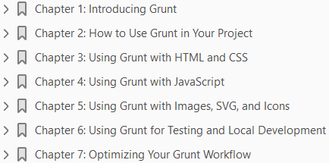
Grunt.js
Ch | Date
1 | 07 May 18
2
3
4
5
6
7
Pro Grunt.js 2015

Slide 3
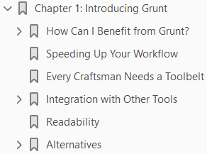
1
Introducing Grunt

Slide 4
Intro
So, you’ve picked up this book with the rather unusual title, and you’re probably wondering what Grunt is or, at least, what all the buzz concerning Grunt has been about for the last 24 months.
To put it simply, Grunt is a JavaScript task runner.
Its primary aim is to automate repetitive tasks, freeing up developers’ time to concentrate on the more difficult problems they face every day.
Grunt is written in JavaScript on top of Node distributed via npm and was created by Ben Alman (https://github.com/cowboy).
Since day one, Grunt has featured an application program interface (API) to allow developers to extend and add custom tasks to suit their own process.
This high customization has lead Grunt to become extremely popular with a large ecosystem that is constantly expanding.
As a task runner, one of the core concepts of Grunt is “tasks.”
Each task has a set of configuration options that can be tuned to meet your specific needs.
Tasks can also have multiple versions: for example, one set of configuration for development and another for production.

Slide 5
Intro |
In addition, Grunt has a well-documented API that enables developers to change the behavior of their task runner at runtime.
Throughout this book, Grunt will be used to demonstrate how this small yet extremely powerful tool can be used to optimize your developer workflow.
Grunt is often portrayed as being a tool solely for front-end engineers; however, I will also demonstrate how projects that aren’t solely front-end focused can also benefit from the introduction of Grunt.

Slide 6
How Can I Benefit from Grunt?
One of the key benefits and primary objectives of Grunt is automation.
You may question why you need automation, when your existing workflow works for you.
I hope this book will serve as encouragement and demonstrate how automation can make you more efficient.
Most developers are familiar with the tools required to perform tasks such as
code linting
asset minification
compiling CSS
as part of their workflow.
However, not every developer has this process automated.
Some teams opt to use continuous integration as a point to build their application and perform prerelease checks.
This environment is often controlled outside of the development team, with responsibilities lying elsewhere within an organization.
It is convenient to rely on your continuous integration environment to perform build tasks.

Slide 7
How Can I Benefit from Grunt? |
As a developer, you write code, push it to your central code repository, and your continuous integration (CI) server handles the rest.
However, if you have to replicate an issue locally from a production environment, this may not be the quickest process for you.
With the power of Grunt, you can utilize the same build process easily within your local development and CI environment, reducing the time taken to build a production version of your application locally.
Developers working on their own or in a small team opting to use command-line or graphical user interface (GUI) tools can unify their build process through the use of Grunt.
Unifying the build process will simplify the project setup and maintenance, as there will be a single process to follow.

Slide 8
Continuous Integration
If you are unfamiliar with CI, it is a common development practice of merging code from a team of developers into a central repository.
It is often used to
run unit tests
perform code analysis
automate deployments
Most modern open source projects use TravisCI (https://travis-ci.org/), an open source CI environment that can be easily integrated with GitHub repositories.
Other alternatives that are popular within the development community are Hudson and Jenkins, Jenkins being a fork of Hudson.
Both Jenkins and Hudson have a number of plug-ins available for integrating third-party tools or systems, such as a plug-in that adds the ability to trigger builds on updates to repositories within GitHub.

Slide 9
Speeding Up Your Workflow
There are some fantastic tools and integrated development environments (IDEs) available to help you develop applications and sites that provide tools for common tasks, such as compiling your CSS and linting your JavaScript.
However, such tools typically require an initial setup and can also lead to a disjointed workflow.
You might be wondering what is meant by a “disjointed workflow.”
Consider the following scenario: You’re working a very simple one-page application with a set of JavaScript files, a CSS preprocessor, and a number of images.
Before you release the application, you will have to
lint your JavaScript
compile your CSS
compress your images
For each of these problems, you can choose from a wide range of tools already in existence, such as
JSHint
LESS compiler
pngquant

Slide 10
Speeding Up Your Workflow |
It is likely that your IDE will lint your JavaScript and LESS compilation; however, you would have to switch to the command line to then run pngquant.
Switching between your browser, editor, and command-line interface while developing will distract you from focusing on the key problems that you must solve.
Grunt can provide you with a solution for unifying these tasks.
In addition, Grunt also automates these tasks, so that you can focus on the unique problems within your application.

Slide 11
Every Craftsman Needs a Toolbelt
There is no denying that the craftsmanship of front-end web development has changed dramatically over the last few years.
Gone are the days when valuable development time was consumed by solving browser compatibility issues, as developers now have access to a rich set of tools that handle such trivia.
Utilizing these tools enables developers to invest their time in solving more complex problems with their applications.
The emergence of frameworks that solve everyday tasks, such as Bootstrap and AngularJS, have enabled developers to deliver enhanced experiences through their applications.
Increasingly, users are accessing applications from mobile devices and have an expectation that web applications should offer the same experience as native mobile applications.
The increased volume of traffic to applications from mobile devices has also forced developers to rethink how they engineer their applications, adding further complexity.
To combat this, a developer has to build a set of reliable tools that can be used time and time again.
Grunt should become one of your primary tools that form part of your toolbelt.

Slide 12
Every Craftsman Needs a Toolbelt |
Due to the modular nature of Grunt, it is quite easy to build a recipe book of tasks that can be used across multiple projects.
Each task focuses on a single problem, and it is easy to mix and match configurations across projects to build a powerful set of tools for each context.

Slide 13
Integration with Other Tools
There is no denying that tools available for front-end engineers have dramatically improved over the last 24 months.
One particular project that has seen substantial development by the community is Yeoman.
Coined as a workflow instead of a framework, Yeoman consists of three key components:
Yo
Grunt
Bower
Grunt is a key player in the Yeoman project, and, as illustrated later in the book, combining Yo and Grunt together provides the ability to rapidly scaffold projects that include an automated build process.

Slide 14
Versioning
Another key benefit of using Grunt is that your tasks are versioned along with their configuration.
As Grunt tasks within a project are installed by npm, these are easily managed using npm itself.
In addition to this, the configuration changes are clearly visible to the whole team as they are versioned with the project.
This builds a toolset that the whole team can learn, develop, and benefit from.

Slide 15
Note
npm is a package manager for JavaScript, allowing developers to easily share and reuse JavaScript modules.
npm handles the
Versioning
Dependencies
publishing of packages
Each package has metadata defined in a JSON configuration file, called package.json, which contains information such as
Name
Description
Version
Authors
Dependencies

Slide 16
Readability
Another factor contributing to Grunt’s rapid growth in popularity is its readability.
Grunt’s task configuration is a simple JSON configuration object, making it
highly readable
understandable
Grunt also promotes the development technique of Don’t Repeat Yourself (DRY), as tasks can use variables as part of their configuration.
As you’ll see later in the book, this also improves the readability of task configuration.
A further benefit of having a readable task runner is to dramatically reduce the time required for new team members to get up to speed on how the build process works.

Slide 17
Alternatives
It’s good to be aware that Grunt wasn’t the first task runner to automate developer workflow.
There are a number of alternatives; however, Grunt stands tall among them, due to its vast ecosystem, simplicity, and speed.
We’ll briefly look at a few popular alternatives before delving into Grunt.

Slide 18
Ant
Formally known as Apache Ant, “Ant” is a Java-based build tool.
Rather than specifying tasks using JavaScript, tasks are defined in an XML file in your project.
Ant comes packaged with more than 100 built-in tasks, such as
concatenation of files
gzipping files
replacing contents within a file
However, these tasks are slightly more oriented toward a build process for a Java project.
For example, if you want to support JavaScript linting, you will have to include a new task.
To add such tasks, Ant requires the new tasks to be compiled as JAR files and referenced from the XML configuration.
For those unfamiliar with Java, this might be a little daunting when you first get started.
Grunt might be a better fit if your project doesn’t require Java as part of the build process, as this adds an unnecessary dependency to the project.
You may consider choosing Grunt over Ant owing to the configuration format use: JSON instead of XML.
Reading an Ant build file feels a little bloated, and it isn’t obvious at a glance how a build process hangs together, while Grunt’s JSON is leaner, and tasks can be combined into logical names.

Slide 19
Rake
Rake is the Ruby community’s answer to Make files.
Rake allows developers to define tasks using Ruby syntax.
Anybody who has used the Ruby on Rails framework should be reasonably familiar with Rake, as it’s used as the tool of choice for tasks such as
the creation of databases
running tests
compiling static assets
Rake does not have a concept of task configuration.
Instead, it opts for tasks that define and execute Ruby to achieve its goals.
For example, there are no repositories of recipes or plug-ins available to perform common tasks.
If you want to concatenate and lint your JavaScript, you will have to start from scratch and write your task before you can use it.
This will obviously make it more costly to get started on your projects, as Rake doesn’t offer anything up front. It is up to you to ensure that your tasks are highly configurable to increase reuse across projects.

Slide 20
Rake |
Grunt solves the problem of having to reinvent the wheel by offering a wide selection of plug-ins.
In addition, Grunt also promotes the concept of configuration over code, by providing a rich API for supporting task configuration.

Slide 21
Gulp
Gulp is a relatively new tool that is, like Grunt, JavaScript-based.
Another similarity between Grunt and Gulp is the modular-based architecture, powered by the use of npm as a dependency manager.
Gulp, like Grunt, is easy to get started; however, arguably, Gulp has more succinct task definition, as tasks are expressed in code instead of configuration.
There have been several blog posts that pit Grunt and Gulp against each other.
However, there have also been counter arguments stating that both tools can coexist, owing to differences in how they achieve a common set of goals.
Gulp is faster than Grunt, yet the barrier to entry is a little higher, due to its use of Node streams.
Grunt combines tasks in which the output of one task produces a temporary file that is picked up by the next task for processing.
Gulp doesn’t produce these temporary files; files are piped between each task.

Slide 22
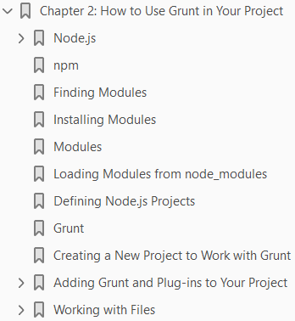
2
How to Use Grunt in Your Project

Slide 23
Intro
In the previous chapter, you received a brief introduction to Grunt and the benefits of using Grunt in your projects.
This chapter will take a more detailed look at Grunt, how to install Grunt, and how to use Grunt in your projects.
Before looking at Grunt itself, it is important to have a good understanding of Node.js.
Grunt is built on top of Node.js, so having a good understanding of Node.js and how modules operate within Node.js will make learning and understanding Grunt easier.

Slide 24
Node.js
Node.js is an application platform that allows developers to implement event-driven applications built on top of Chrome’s JavaScript engine, V8.
As many of you will know, JavaScript originated as a client-side language; it was used to implement interactive interfaces.
Node.js utilizes JavaScript as a scripting language on the server side and achieves high scalability through non-blocking I/O operations.
To achieve non-blocking I/O operations, Node.js applications use asynchronous execution, whereas, traditionally, applications execute code in a given sequence.
Non-blocking I/O is a process that allows other processing to continue while waiting for a response from an expensive I/O operation.
For example, if a Node.js application sends a request to a remote HTTP service for data, it does not wait for a response before processing other requests.
Upon the request being sent to the remote HTTP service, the Node.js application will continue to process other requests before returning to the original routine, once the remote HTTP service has responded.
This ability to continue processing other requests while waiting for I/O operations can provide significant performance improvements.

Slide 25
Node.js |
Node.js was created by Ryan Dahl in 2009.
His inspiration came from his experience of web sites that would continuously poll servers for updates.
Dahl wanted to create a framework that was event-driven and allowed servers to push data to the browser, instead of data being polled continuously.
Node.js is available across multiple platforms: Linux, Windows, and Mac OS X.
The installation process for each is relatively easy, and you will have to install Node.js before you can use Grunt.

Slide 26
Installing on Linux

Slide 27
Installing on Windows
For readers using Windows, head over to http://nodejs.org/ and download the Windows installer.
Once you have completed the installation process, Node.js will be available.

Slide 28
Installing on Max OS X

Slide 29

Confirming Your Installation
After completing the preceding installation steps, Node.js will be available to you.
As part of the installation npm, a package manager, for now, was also installed.
Prior to version 0.6.3 of Node.js, npm was installed separately.
To confirm that node and npm are available, open the terminal, or command prompt in Windows, and type the following:
You should have a similar version number to the one shown in Figure 2-1 in the respective environments.
For the remainder the book, we will be using Node.js version 0.10.26 and npm version 1.4.3, as illustrated in Figure 2-1.

Slide 30
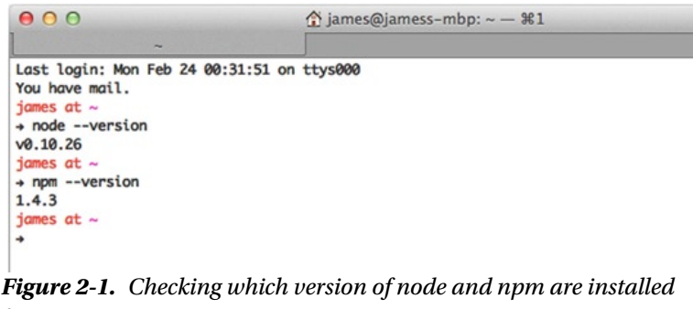
Figure 2-1

Slide 31
npm
npm provides a convenient way to create, share, and install Node.js packages across several projects.
Packages are published to a central npm registry allowing developers from across the globe to install and reuse these packages within their own project.
npm provides a standard approach to defining JavaScript packages that can be easily reused across projects.
Each package has a
Name
Description
author(s)
a set of dependencies
As mentioned in the previous chapter, Grunt uses a plug-in-based architecture, allowing developers to mix and match tasks across projects.
To achieve this extreme flexibility, Grunt harnesses the existing modularization offered by Node.js and npm.
Each Grunt plug-in is a Node.js package that can be installed using npm. npm allows developers to define a package’s dependencies.

Slide 32
Npm |
When others install a package, npm manages the installation and its dependencies so that you don’t have to worry.
Before taking a first look at Grunt, I’ll cover two key features of Node.js and npm that we will use when installing and using Grunt.

Slide 33

Finding Modules
npm allows developers to search a registry of all Node.js packages.
Searches against a registry accept one or more search terms.
A search term can also be a regular expression, these start with a /.
To search for a package, open the command line or command prompt and enter
This will return all the Node.js packages that contain the word grunt in the title, description, author, and/or tags.
You will see later in the chapter how to define this metadata for a package.
The results of your search should look similar to those shown in Figure 2-2, with the search term highlighted.
The first time npm search is run against a repository, a local index is built.
This local index contains a reference to all the packages within the searched repository.
The local index is intended to speed up future searches but may take some time if you run the search command while on a small network.
The results returned from a search contain the module name and the description in columns, respectively.

Slide 34


Finding Modules |
If a search is performed for a particular package author, the author column is also displayed.
For example, a search for “jrcryer” will return all plug-ins written by me (see Figure 2-3).
The quickest way to find a Grunt plug-in is to search for the tag “gruntplugin.”
This is the suggested tag that plug-in authors are advised to associate with their plug-ins.
This tag can be combined with an additional qualifier to return plug-ins for a particular task.
For example, to search for Grunt plug-ins associated with PHP, the following search can be performed:
Once you’ve found the package you’re looking for, you have to install it.
You’ll see in the next section how npm makes this process trivial.

Slide 35
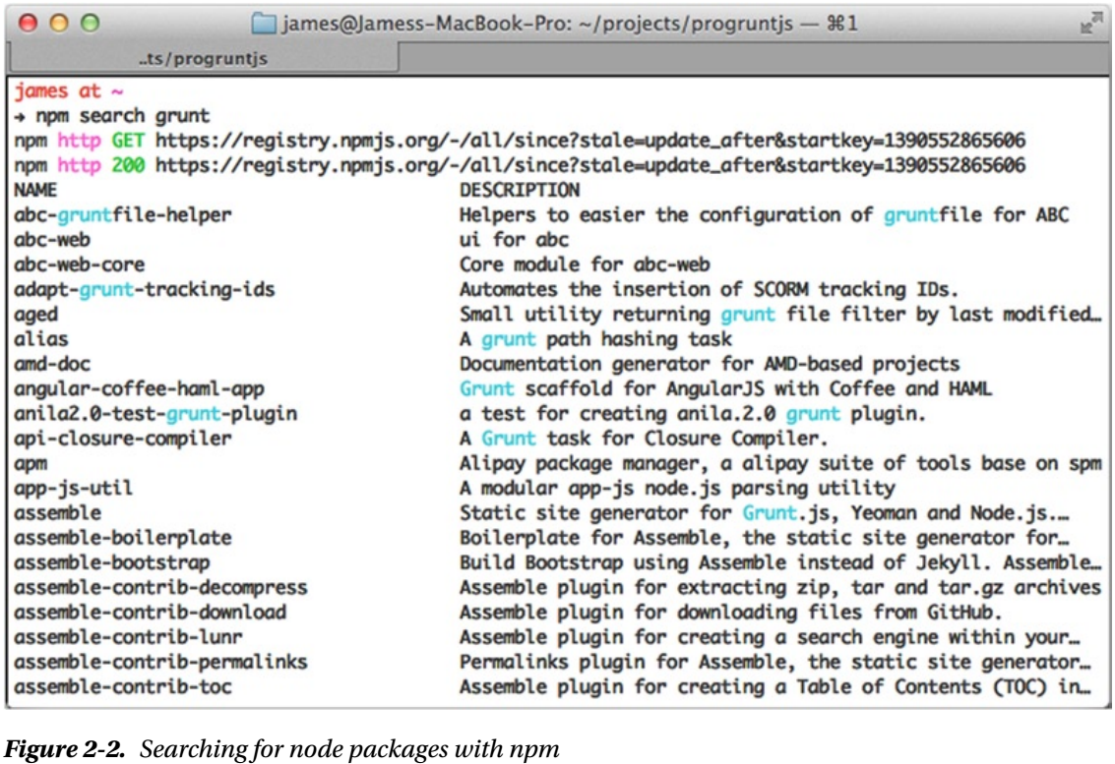
Figure 2-2

Slide 36
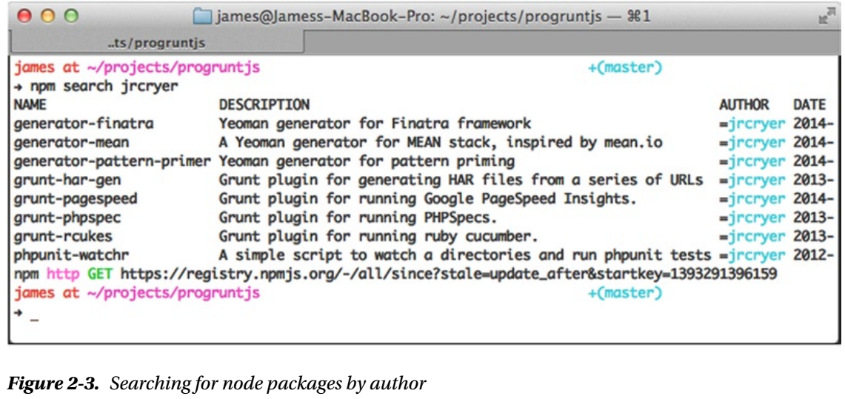
Figure 2-3

Slide 45
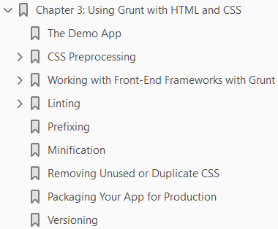
3

Slide 46
Intro

Slide 47
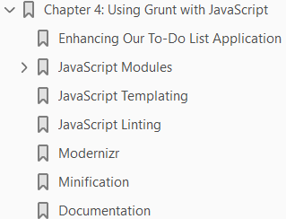
4

Slide 48
Intro

Slide 49
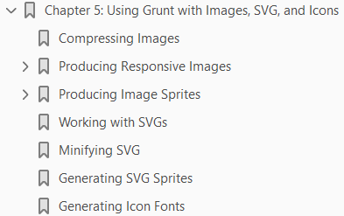
5

Slide 50
Intro

Slide 51
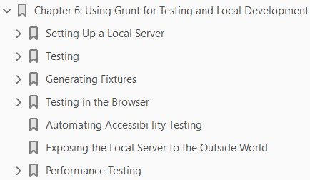
6

Slide 52
Intro

Slide 53
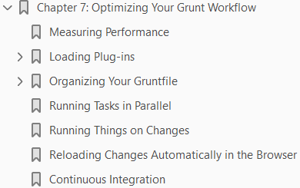
7

Slide 54
Intro

